Slide 1

ECB1204 – ANALOG INTEGRATED CIRCUIT DESIGN DARKNESS DETECTOR
Presented by:
P DIVYASHRI (2303811710622023)
KANISHKA L (2303811710622049)
KEERTHIGA T (2303811710622052)
Under the Guidance of
MR.PARTHIBARAJ
ASSISTANT PROFESSOR
ELECTRONICS AND COMMUNICATION

Slide 2
ABSTRACT
This project involves designing and implementing a Light Sensor and Darkness Detector using the IC 741 operational amplifier (op-amp) in analog circuits. The primary objective is to create a circuit that can automatically detect light intensity and activate an output signal when darkness is detected. The circuit uses a Light Dependent Resistor (LDR) as the light sensor, which alters its resistance based on the ambient light.
The IC 741 is configured as a comparator that compares the voltage from the LDR with a reference voltage, allowing it to detect changes in light levels. When the ambient light falls below a certain threshold, the comparator triggers an output signal, typically lighting up an LED to indicate darkness.
This simple, cost-effective project has practical applications in automation systems such as automatic lighting, day-night switches, and security systems.

Slide 3
INTRODUCTION
The primary objective of this project is to design and develop a light sensor and darkness detector using the IC 741 operational amplifier, which can automatically detect changes in ambient light and activate an output signal to indicate the presence or absence of light.
The system aims to Detect varying levels of light using a Light Dependent Resistor (LDR) and respond appropriately by turning on an indicator (LED) when the light level drops below a pre-set threshold.
It serve as a simple, cost-effective solution for real-time monitoring and response to changes in light conditions.

Slide 4
OBJECTIVE
To design and implement a light sensor and darkness detector using an IC 741 operational amplifier. The circuit will utilize an LDR to sense ambient light intensity and a comparator mechanism to distinguish between light and dark conditions. A variable resistor will set the light threshold for detection. When darkness is detected, an LED will be activated, serving as a visual indicator. This system is suitable for applications such as automatic night lamps or light-sensitive alarms.

Slide 5
PROBLEM STATEMENT
In many environments, there is a need for an efficient and reliable system to detect light and darkness for automation and energy-saving purposes. Existing solutions may be complex or costly, making them less accessible for simple applications. Using readily available components such as an IC 741 op-amp, LDR, and LED, there is a need to design a compact and affordable circuit capable of distinguishing between light and dark conditions. The circuit should provide a visual indication (via an LED) when darkness is detected, with adjustable sensitivity for varying light conditions. This project addresses the challenge of creating a low-cost, easy-to-build light detection system for practical use.

Slide 6
TECHNOLOGY OVERVIEW
The light sensor and darkness detector circuit is built using an IC 741 operational amplifier in a comparator configuration, which compares input voltages to produce a binary output. The LDR serves as a light-sensitive component, changing its resistance based on the intensity of ambient light. A variable resistor is used to set the threshold voltage for light detection, allowing for adjustable sensitivity.

Slide 7
COMPONENTS USED
IC 741 op-amp
10 k resistor
LDR
Variable resistor 102 - 1k
Resistor 220 ohm
Led (Red colour)

Slide 8
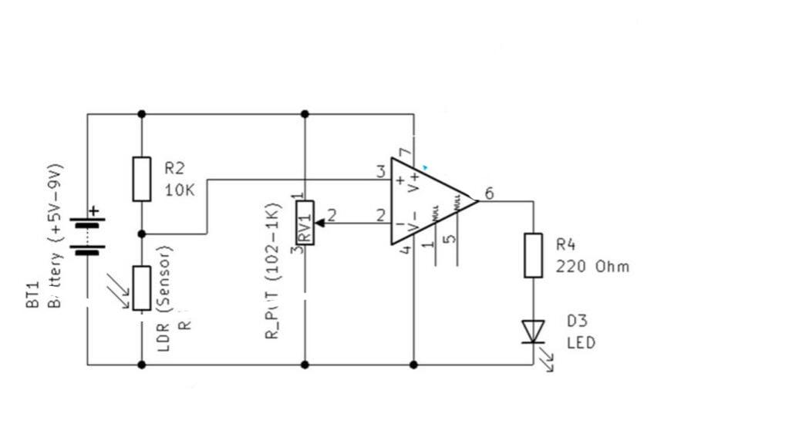
BLOCK DIAGRAM

Slide 9
WORKING PRINCIPLE
The LDR and R2 form a voltage divider. The voltage at the junction of R2 and the LDR depends on the LDR’s resistance, which changes with light intensity . In bright light, the LDR’s resistance is low, and the voltage at the junction decreases. In darkness, the LDR’s resistance is high, and the voltage increases.The potentiometer (RV1) sets a reference voltage at the non-inverting input of the operational amplifier (pin 3). This voltage is used to define the threshold level for light intensity.

Slide 10
APPLICATION
The light sensor and darkness detector can be used in automatic lighting systems to activate lights during low-light conditions, improving energy efficiency.
It can serve as a night lamp controller, turning on LEDs automatically in darkness.
The circuit can also be implemented in security systems to detect unauthorized entry during nighttime.
It is suitable for agricultural applications, such as monitoring light levels in greenhouses.
Additionally, it can be used in educational projects to demonstrate the principles of light detection and comparator circuits.

Slide 11
BENEFITS
Energy Efficiency: The system helps conserve energy by activating lights only in darkness.
Cost-Effective: Uses affordable and readily available components, making it an economical solution.
Adjustable Sensitivity: The variable resistor allows customization of light detection thresholds for various applications.
Automation: Eliminates the need for manual light control, enhancing convenience in homes and workplaces.
Versatile Applications: Can be used in security systems, night lamps, and agricultural setups, showcasing flexibility.

Slide 12
CHALLENGES
Sensitivity to Environmental Factors: Variations in ambient light conditions or temperature can affect the LDR's performance and accuracy.
Limited Range: The circuit is effective only for detecting light changes within a short distance.
Power Supply Requirements: The IC 741 requires a dual power supply (+9V and -9V), which might not be readily available in all setups.
Fixed Functionality: The circuit is designed specifically for light detection and cannot adapt to other sensing applications without modifications.
Component Aging: Over time, components like the LDR and variable resistor may degrade, affecting reliability and requiring periodic maintenance.

Slide 13
ENVIRONMENT IMPACT
Energy Conservation: By automatically activating lights only in darkness, the system reduces unnecessary power consumption, contributing to energy efficiency.
Reduced Carbon Footprint: Minimizing electricity usage helps lower greenhouse gas emissions associated with energy production.
Eco-Friendly Components: The circuit uses basic, non-toxic components, posing minimal environmental hazards during usage.
Waste Management: Proper disposal of electronic components like the IC and resistors is necessary to prevent environmental harm.
Sustainable Automation: Promotes smart energy solutions, encouraging sustainable practices in homes and industries.

Slide 14
HARDWARE MODULE
The hardware module of this project consists of several components that work together to detect ambient light levels and indicate the presence of darkness. Below is a breakdown of the hardware components:
Power Supply - +12V and -12V Power Source
Light Sensor (LDR) - The LDR is the key sensor in this circuit, which detects changes in ambient light.
Operational Amplifier (IC 741) - The IC 741 is used as a comparator to compare the voltage across the LDR
Breadboard - For prototyping and testing, the circuit can be assembled on a breadboard.
Potentiometer - A variable resistor (potentiometer) is used to adjust the reference voltage at the non-inverting input of the IC 741.
LED - A light-emitting diode is connected to the output of the IC 741 to indicate darkness.

Slide 15
ADVANTAGES AND APPLICATIONS
Cost-Effective: The components used, such as the IC 741, LDR, and resistors, are inexpensive and readily available, making the project cost-effective.
Low Power Consumption: The circuit consumes very little power, making it suitable for low-energy applications such as battery-powered devices.

Slide 16
CONCLUSION
The Light Sensor and Darkness Detector project using the IC 741 operational amplifier successfully demonstrates a simple yet effective way to detect changes in ambient light and automatically activate an output in response to darkness.
This project highlights the efficiency and cost-effectiveness of analog electronics in designing real-world solutions. The ability to adjust the light sensitivity via a potentiometer adds flexibility, making the system adaptable to different environments.
Overall, the project provides a solid foundation for automation systems where light sensing is essential and can be expanded for more complex applications with further modifications or integrations.

Slide 17
PROJECT PLAN
This project plan outlines the timeline and milestones for developing the *Light Sensor and Darkness Detector. The plan is divided into several phases, each focusing on different aspects of the project, from research and design to testing and final implementation. The estimated timeline for this project is 6 weeks.
Phase 1: Research and Component Selection
Phase 2: Circuit Design and Simulation
Phase 3: Prototyping
Phase 4: Testing and Optimization
Phase 5: PCB Design
Phase 6: Final Testing, Integration, and Documentation

Slide 18
REFERENCES
“Op-Amps for Everyone” by Ron Mancini
“Operational Amplifiers and Linear Integrated Circuits” by Robert Coughlin and Frederick Driscoll.
"Electronic Devices and Circuit Theory" by Robert L. Boylestad and Louis Nashelsky

Slide 19
THANK YOU

